Slide 1
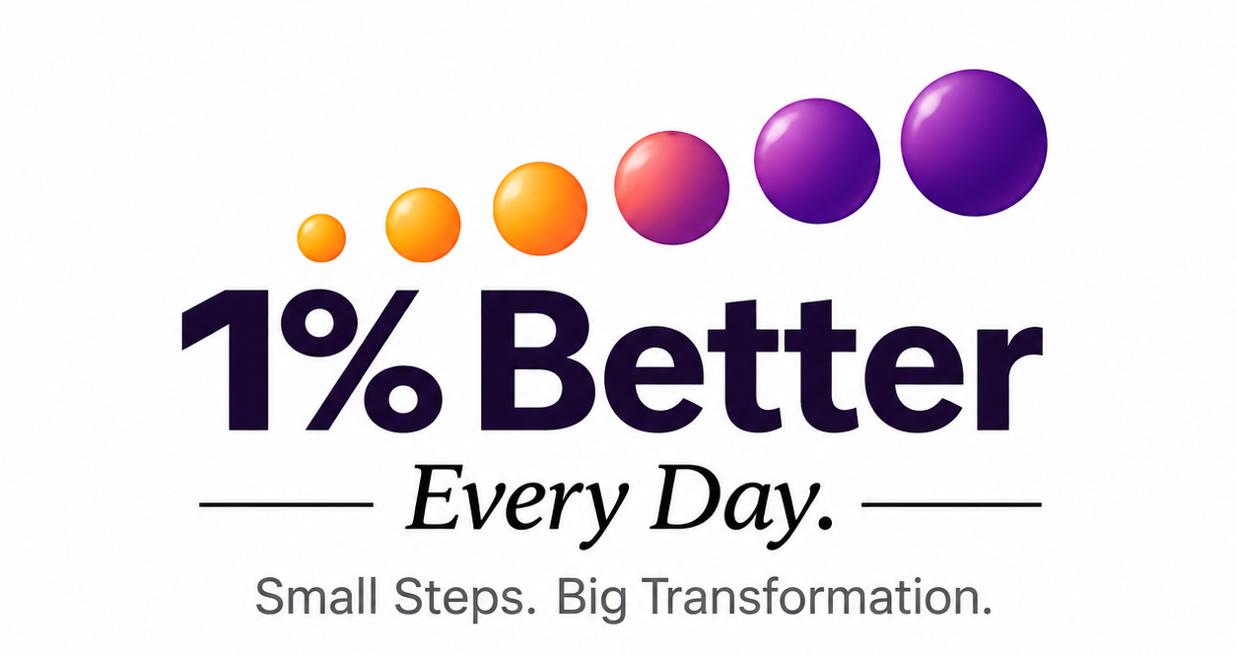
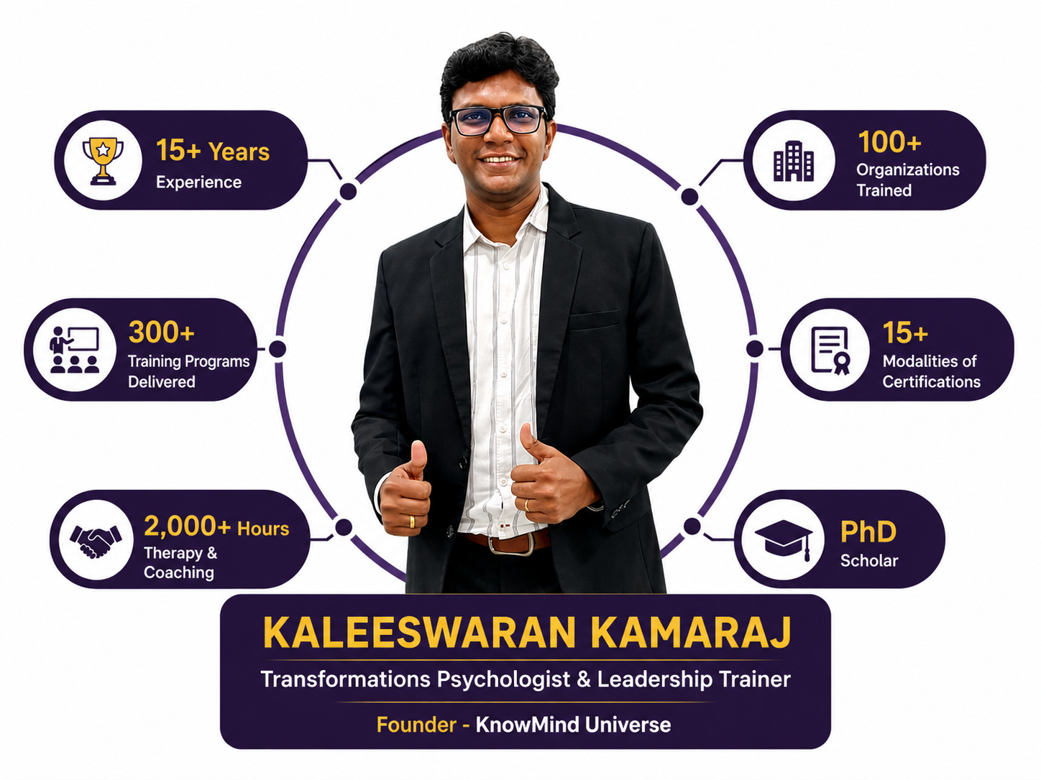
Hero Page
A KnowMind Universe Initiative
EVERY TRANSFORMATION STARTS WITH 1%
Are You Ready to Understand Yourself Better—and Become 1% Better Every Day?
A 14-Day Live Psychological Growth Journey to help you notice your patterns, build self-trust, and create meaningful change—one small step at a time.
Understand Yourself
Notice Your Patterns
Build Self-Trust
Keep Returning
14 Days. | 45 Minutes a Day. |One Small Commitment. | One Better Relationship With Yourself.
🌅 LIVE | 5:30 AM | Zoom
₹699 | Limited Batch
[ AARAMBIKALAMA? → ]
“Paravala Paathukalam… Aarambikalam. ❤️

Slide 2
VSL 🎥 "Oru Chinna Kelvi Ungalukku..."
1.5–2 minutes maximum

Slide 3
Does This Sound Like You?
You Know You Can Do Better… But Something Keeps Pulling You Back.
You know what you need to do But knowing doesn't always become action.
You genuinely want to change You start with energy and good intentions.
But somewhere along the way, you stop Life happens. Motivation drops. Old patterns return.
Then you start again… and the cycle repeats Start. Stop. Feel guilty. Promise yourself. Restart.
You are not lazy.
Maybe you are simply exhausted from starting again and stopping again. Maybe You Don't Need Another Motivation Session.
Maybe it's time to understand yourself better.
Your patterns. Your inner voice. Your relationship with yourself.

Slide 4
WHAT IS 1% BETTER EVERY DAY?
You Don't Have to Change Your Whole Life Today.
You Just Have to Begin With One Small Step.
Real transformation rarely happens because of one big decision.
It happens in small moments.
One honest reflection. One better choice. One promise you keep to yourself.
And when you miss a day?
You don't give up.
You return. And begin again.
The 1% Better Philosophy
AWARENESS
Notice what is happening within you. You cannot change what you don't notice.
↓
CHOICE
Awareness gives you a choice. You can respond differently.
↓
REPETITION
One better choice is not enough. Return. Practice. Repeat.
↓
GROWTH
Small actions become new patterns. And new patterns slowly shape who you become.
This Is Not About Perfection.
It's about becoming:
A little more aware. A little more honest. A little more intentional.
Just 1% Better. Every Day.
Paravala… Paathukalam. Aarambikalam. ❤️

Slide 5
YOUR 14-DAY GROWTH JOURNEY 14 Days. 14 Powerful Conversations with Yourself. This is not about learning more. It's about pausing, reflecting, and practicing.
WEEK 1 — UNDERSTAND YOURSELF 🧠
Day 1 — Awareness
Notice what is within you.
Day 2 — Patterns
Understand the patterns shaping your life.
Day 3 — Self-Trust
Build trust by keeping small promises to yourself.
Day 4 — Playfulness
Bring more joy and lightness into your journey.
Day 5 — Comparison
Learn from others without losing yourself.
Day 6 — Inner Coach
Change the way you speak to yourself.
Day 7 — Integration
Pause. Reflect. Connect the dots.
WEEK 2 — MOVE FORWARD 🌱
Day 8 — Gratitude
Notice what is already present in your life.
Day 9 — Dreams
Give yourself permission to want more from life.
Day 10 — Vision
Turn your dreams into direction.
Day 11 — Doing Nothing & Being
Pause. Observe. Respond instead of reacting.
Day 12 — Repetition & Resilience
Keep returning. Keep practicing. Keep growing.
Day 13 — Self-Love
Accept yourself while continuing to grow.
Day 14 — Reflection & Continuation
Turn experience into wisdom and move forward.
One Day. One Insight. One Small Practice.
You don't have to do everything at once.
Just show up for yourself.
Ready to Begin Your 14-Day Journey?
[ YES, I WANT TO JOIN → ]

Slide 6
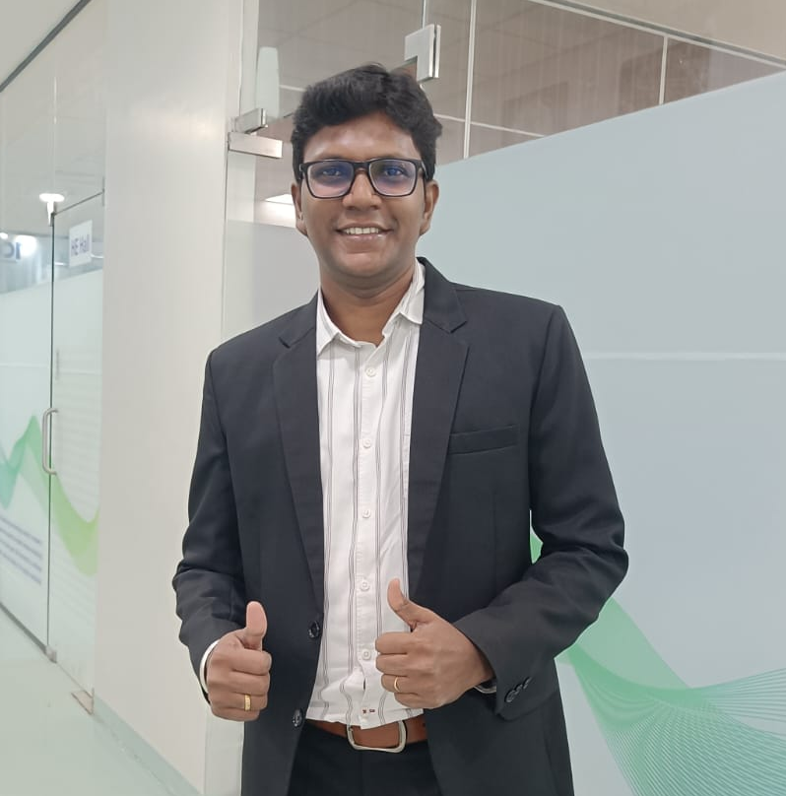
MEET the Psychologist & Trainer
For the past 15+ years, I have been working with individuals, professionals, leaders and organisations to understand one important question:
Why do we know what to do… but still struggle to do it consistently?
Through my work in psychology, coaching, training and personal transformation, I have seen something clearly:
Knowledge alone doesn't create change. Awareness, practice and repetition do.
That is one of the reasons behind creating:
1% Better Every Day.
My Approach
I don't believe transformation comes from simply telling you what to do.
My role is to help you:
🧠 Understand yourself better 👀 Become aware of your patterns 💭 Ask better questions 🎯 Take meaningful action 🔁 Keep returning to the practice
Because ultimately,
I cannot change your life for you.
But I can walk with you, guide you, and help you understand the path better.
Let's begin. One small step at a time. Paravala… Paathukalam. Aarambikalam. ❤️

Slide 7










Media Featureds

Slide 8

Trusted by Professionals & Organisations

Slide 9
What Participants Say About the Journey The best way to understand a journey is to hear from the people who experienced it.
★★★★★ "The content touched things I knew but never faced honestly. Day 1 itself created a real shift." — Deepa Sai Entrepreneur
★★★★★ "The importance of measurable goals and daily progress became clearer. Kalee made that real." — Vijaya Saravanan Entrepreneur
★★★★★ "This program helped me understand why I was losing focus. Now I know how to return when I drift." — Saranyadevi Accountant
★★★★★ "This 14-day journey helped me become more aware, compassionate, and conscious in how I respond to life. I loved that it wasn't about perfection - it was simply about becoming 1% better every day.” — Pavithra Psychologist
Testimonials
Your Journey Could Be the Next Story.
Paravala Paathukalam… Aarambikalama?

Slide 10
HOW DOES THE 14-DAY JOURNEY WORK?
Join the Journey
Register for the 14-Day 1% Better Every Day journey.
2️⃣ Join Live at 5:30 AM
Start your morning with a focused live Zoom session.
⏰ Short. Simple. Practical.
3️⃣ Reflect & Practice
Each day, explore one psychological principle and take a small action into your day.
🧠 Understand → Reflect → Practice
4️⃣ Stay Connected for 14 Days
Be part of a community of people who are also choosing to become better—one small step at a time.
5️⃣ Complete Your Journey
Reflection is where experience becomes learning.
At the end of 14 days, pause and see:
What changed? What did you learn about yourself? What will you continue?
A small clarity box:
📅 Duration: 14 Days 💻 Format: Live on Zoom ⏰ Time: 5:30 AM 🎯 Focus: Psychological Growth & Daily Transformation
You don't have to change your whole life in one day.
Just show up for one small step. Today.
பரவால பார்த்துக்கலாம்… ஆரம்பிக்கலாம். 🌱
[ START YOUR 14-DAY JOURNEY → ]

Slide 11
WHAT WILL YOU EXPLORE IN 14 DAYS?
14 Days. 14 Powerful Shifts. 🌱
Over 14 days, you will explore:
🧠 Your Mind
Awareness • Patterns • Inner Critic • Comparison
❤️ Your Relationship with Yourself
Self-Trust • Playfulness • Gratitude • Self-Love
🎯 Your Direction
Dreams • Bucket List • Vision • Goals
🧘 Your Inner Stability
Non-Reactivity • Repetition • Resilience • Reflection
This is not about becoming someone else.
It is about understanding yourself better—and becoming more intentional about the person you are becoming.
One day. One insight. One small step.
1% Better. Every Day.

Slide 12
WHO SHOULD JOIN?
WHO NOT JOIN?
If you are Entrepreneur / Professional / Freelancer / Anyone who wants to grow
This Journey Is For You If...
🌱 You want to work on yourself
Not because everything is wrong—but because you know there is more to understand and improve.
🔄 You keep starting but struggle to continue
You want to understand why certain patterns repeat in your life.
🧠 You are tired of only consuming motivational content
You want to pause, reflect and actually apply something.
🤝 You want to rebuild self-trust
By starting small and keeping promises to yourself.
🎯 You want more clarity
About your thoughts, patterns, choices and the direction you are moving in.
❤️ You want a better relationship with yourself
Less self-criticism. More awareness. More conscious growth.
🔁 You are willing to show up imperfectly
You may miss a day. You may struggle.
But you are willing to return.
❌ This may not be for you if...
You are looking for a quick fix. 14 days can begin a journey—but it cannot magically solve everything overnight.
You only want motivation and entertainment. This journey involves reflection, dedication and small actions.
You expect someone else to change your life. I can guide the process, but your participation matters.
You are not willing to spend a few minutes reflecting on yourself.
You are looking for individual therapy or clinical treatment. This is a psychological growth and learning journey, not individual therapy or emergency mental health support.
You don't have to be highly disciplined to begin.
You don't have to have your entire life figured out.
You just need a willingness to start.
பரவால பார்த்துக்கலாம்… ஆரம்பிக்கலாம். 🌱

Slide 13
🎁 BONUS OFFER
📘 14-Day Reflection Workbook
Reflect, learn and apply your daily insights. Worth ₹299
🪞 Self-Trust Assessment
Understand your self-trust, consistency and ability to restart. Worth ₹499
🌱 30-Day Continuation Tracker
Keep your 1% Better journey going beyond 14 days. Worth ₹299
🎁 Total Bonus Value: ₹1,097
Included FREE with the 14-Day Journey.

Slide 14
Why live?
There is no recording for the first four batches. That is a deliberate choice, not a limitation.
Presence
You show up at a real time, with real people. That is what makes it count.
Reflection
Reflection happens in the room, not later in a playlist you mean to finish.
Participation
You are asked. You answer. Something moves.
Community
Committed people, returning to the same morning, for fourteen days.
Recorded courses have their place - most of us own several we never finished. This one asks for something different: that you show up, once a day, for fourteen days. That is the whole mechanism.

Slide 15
🛡️ My promise to you
Attend all 14 days.
Complete the daily reflection every night.
If you feel no shift in your awareness, self-trust, or 1 % Better on any habits - I will return every rupee.
No questions asked.
I am that confident in what these 14 days will do for you.
Refund applies to participants who attend all 14 sessions and complete all 14 day reflections.

Slide 16
FREQUENTLY ASKED QUESTIONS
1. What is 1% Better Every Day?
A 14-day live psychological growth journey designed to help you understand your patterns, build self-trust and take small steps towards meaningful change.
2. What time are the sessions?
⏰ 5:30 AM
Each live session is designed to be around 45 minutes.
3. Do I need to attend all 14 days?
We strongly encourage you to attend all 14 days to experience the complete journey.
But remember:
Progress, not perfection.
If you miss a session, don't give up on the journey.
4. What language will the sessions be in?
The sessions will be conducted in a simple mix of Tamil and English, making psychological concepts easy to understand and relate to.
5. Is this therapy?
No. This is a psychological learning and personal growth program, not individual therapy or clinical treatment.
6. Do I have to speak or share personally?
No. You can participate at your comfort level.
There may be opportunities to reflect and interact, but you are not forced to share personal experiences.
7. Who can join?
Entrepreneurs, professionals, freelancers—and anyone genuinely interested in working on themselves and growing.
8. What if I complete everything but feel no value?
That is where My Promise to You applies.
Attend all 14 sessions and complete all 14 daily reflections. If you genuinely feel no shift in your awareness, self-trust or consistency, your payment will be refunded according to the stated promise.

Slide 17
Every Transformation Starts With 1%. Are You Ready to Become 1% Better Every Day?
You Don't Have to Change Everything Today.
Just Give Yourself 14 Days.
For the next 14 days:
🌱 Pause for yourself. 🧠 Understand yourself better. 🪞 Reflect honestly. 🎯 Take one small step. 🔁 Keep returning.
Every Transformation Starts With 1%.
Are You Ready to Become 1% Better Every Day?
14 Days. 45 Minutes a Day. One Journey Towards Yourself.
💰 Join the Journey — ₹699
🎁 Including All 3 Bonuses
📘 14-Day Reflection Workbook 🪞 Self-Trust Assessment 🌱 30-Day Continuation Tracker
Total Bonus Value: ₹1,097 — Included Free
பரவால பார்த்துக்கலாம்… ஆரம்பிக்கலாம். 🌱
[ YES, I WANT TO GIVE MYSELF 14 DAYS → ]
Small line below CTA:
📅 Limited registrations for the upcoming batch 💻 Live on Zoom | ⏰ 5:30 AM
A KnowMind Universe Initiative

Slide 18
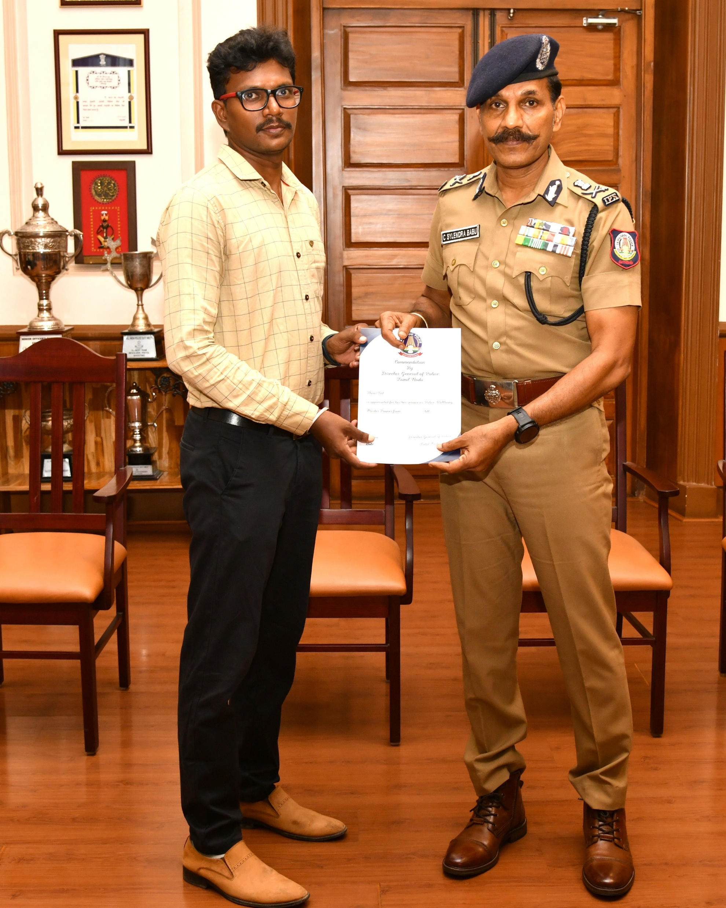
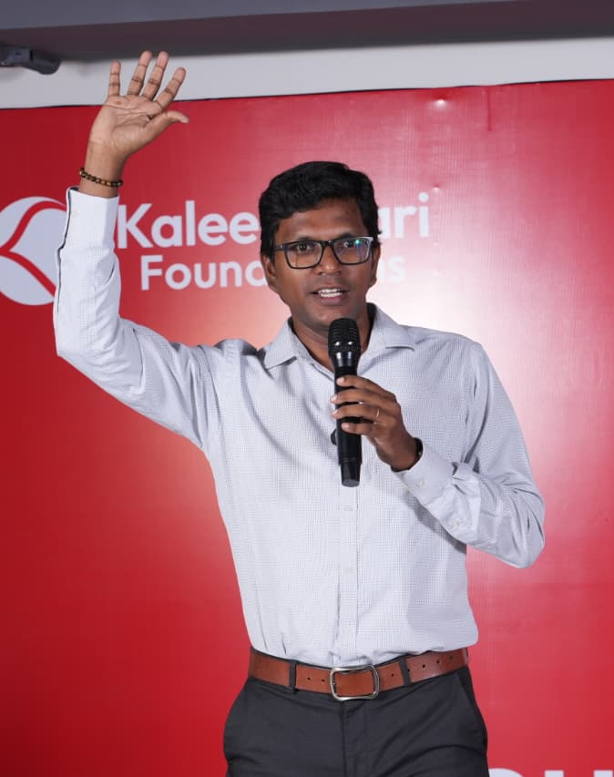
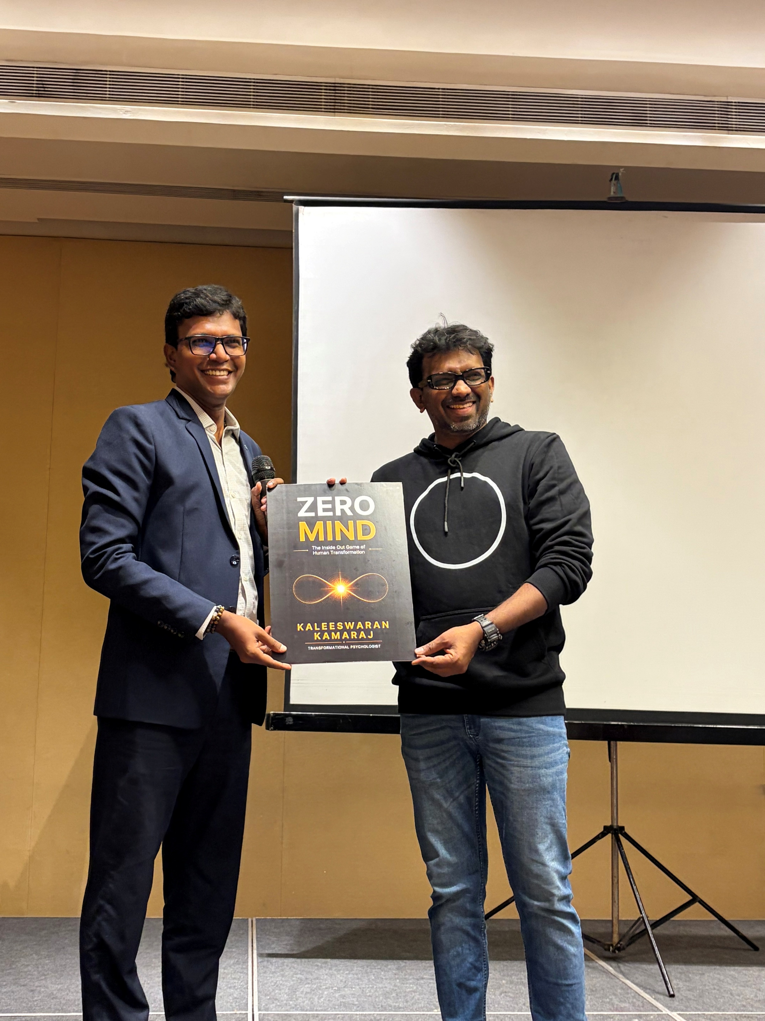
Real time impacts
TN police well-being trainer
Authoring Book – ZERO MIND
Keynote Speeches

